Slide 1
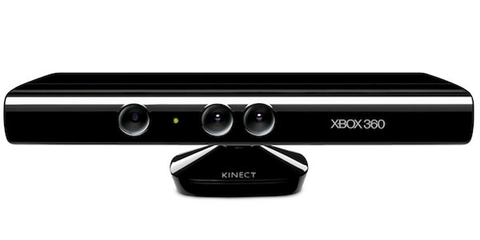
Kinect Workshop
Marco Franssen, Jan Saris
Eindhoven, 9 juni 2011

Slide 2
What will we do tonight
Introducuction
Architecture / Cohesion of projects in the solution
Stuff to think about
Workshop
Optional chapter number (Arial 10 regular)

Slide 3
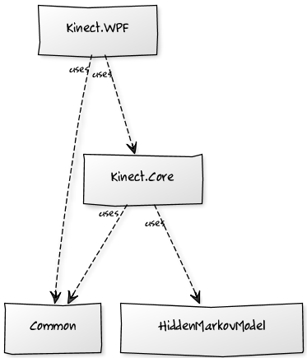
Architecture
Cohesion of the visual studio projects, Semafoor
Optional chapter number (Arial 10 regular)
Notes:
http://yuml.me/diagram/scruffy;dir:td/class/draw
# Kinect Diagram
[Kinect.Core]uses-.->[HiddenMarkovModel]
[Kinect.Core]uses-.->[Common]
[Kinect.WPF]uses-.->[Common]
[Kinect.WPF]uses-.->[Kinect.Core]

Slide 4
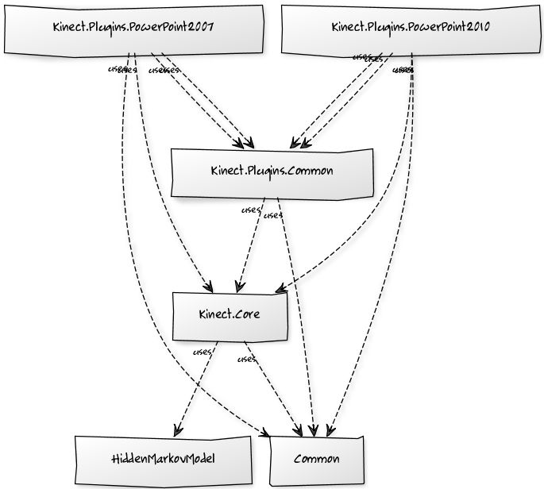
Architecture
Cohesion of the visual studio projects, PowerPoint
Optional chapter number (Arial 10 regular)
Notes:
http://yuml.me/diagram/scruffy;dir:td/class/draw
# Kinect Diagram
[Kinect.Core]uses-.->[HiddenMarkovModel]
[Kinect.Core]uses-.->[Common]
[Kinect.Plugins.PowerPoint2007]uses-.->[Common]
[Kinect.Plugins.PowerPoint2007]uses-.->[Kinect.Core]
[Kinect.Plugins.PowerPoint2010]uses-.->[Common]
[Kinect.Plugins.PowerPoint2010]uses-.->[Kinect.Core]
[Kinect.Plugins.Common]uses-.->[Common]
[Kinect.Plugins.Common]uses-.->[Kinect.Core]
[Kinect.Plugins.PowerPoint2007]uses-.->[Kinect.Plugins.Common]
[Kinect.Plugins.PowerPoint2007]uses-.->[Kinect.Plugins.Common]
[Kinect.Plugins.PowerPoint2010]uses-.->[Kinect.Plugins.Common]
[Kinect.Plugins.PowerPoint2010]uses-.->[Kinect.Plugins.Common]

Slide 5
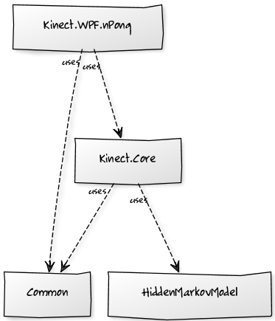
Architecture
Cohesion of the visual studio projects, Pong
Optional chapter number (Arial 10 regular)
Notes:
http://yuml.me/diagram/scruffy;dir:td/class/draw
# Kinect Diagram
[Kinect.Core]uses-.->[HiddenMarkovModel]
[Kinect.Core]uses-.->[Common]
[Kinect.WPF.nPong]uses-.->[Common]
[Kinect.WPF.nPong]uses-.->[Kinect.Core]

Slide 6

Architecture
Cohesion of the visual studio projects, Showcase
Optional chapter number (Arial 10 regular)
Notes:
http://yuml.me/diagram/scruffy;dir:td/class/draw
# Kinect Diagram
[Kinect.Core]uses-.->[HiddenMarkovModel]
[Kinect.Core]uses-.->[Common]
[Kinect.Showcase]uses-.->[Common]
[Kinect.Showcase]uses-.->[Kinect.Core]

Slide 7
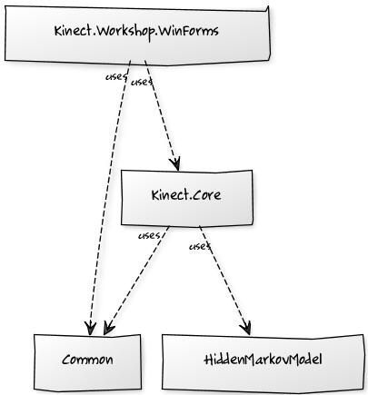
Architecture
Cohesion of the visual studio projects, Workshop
Optional chapter number (Arial 10 regular)
Notes:
http://yuml.me/diagram/scruffy;dir:td/class/draw
# Kinect Diagram
[Kinect.Core]uses-.->[HiddenMarkovModel]
[Kinect.Core]uses-.->[Common]
[Kinect.Workshop.WinForms]uses-.->[Common]
[Kinect.Workshop.WinForms]uses-.->[Kinect.Core]

Slide 8
Stuff to think about
Multi-threading, debugging, performance
Multi-threading
Updating User Interface
Debugging your code
Performance
30 fps
Optional chapter number (Arial 10 regular)

Slide 9
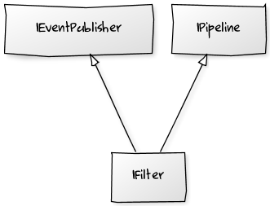

Filters and Gestures
Interfaces
Pipelines
Notes:
# Cool UML Diagram
[IPipeline]^-[IFilter]
[IEventPublisher]^-[IFilter]
# Cool UML Diagram
[User : IEventPublisher]->[MyFilter : IFilter]
[MyFilter : IFilter]->[MyGesture : IPipeline]

Slide 10
Workshop
Hands-on
Part 0:
Installation
Part 1:
Discover MyKinect
Part 2:
Detect User
Read User data
Part 3:
Create a Filter
Create a Gesture
http://atosorig.in/aonlkinect
Optional chapter number (Arial 10 regular)

Slide 11
For more information please contact: Marco Franssen +31 (0)6 83 62 73 00 marco.franssen@atos.net
Jan Saris +31 (0)6 52 54 22 69 jan.saris@atos.net

